Slide 1
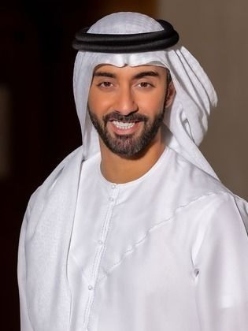







PERSONALITY
BIO
Resilient
Hopeful
Determined
Ahmed fled his home country due to political persecution. He left behind a stable career as an engineer and now seeks safety and a new life for his family. He currently lives in temporary accommodation while awaiting his asylum application decision.
Motivations
LEGAL STATUS & WORK RIGHTS
FAMILY WELLBEING
EDUCATION & CAREER
COMMUNITY INTEGRATION
Goals
Challenges
Access legal resources and track asylum updates.
Find jobs, career guidance, and credential recognition.
Locate educational resources and school enrolment info for his children.
Difficulty with complex asylum processes and unclear guidance.
Difficulty finding job listings for asylum seekers.
Limited knowledge of financial and housing assistance.
Ahmed Abdullah
32, Male
Needs / Wants
Pain Points
Asylum Seeker
Accessible resources and guidance for legal aid
Awareness of jobs in which he can apply for
Temporary and affordable housing
Frustration with unclear legal processes and scattered information.
Anxiety over financial instability and limited job opportunities.
Uncertainty in proving qualifications and finding work.
^{STATUS:}
^{Married}
^{Dependents:}
^{2 children}

Slide 2
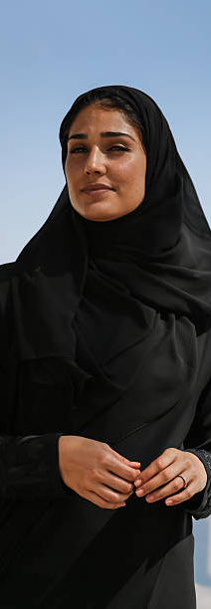

PERSONALITY
BIO
Cautious
Resilient
Independent
Farida left her home country due to gender-based persecution. She travelled alone, enduring hardship and uncertainty, and is now in the process of applying for asylum. She struggles with trauma and adjusting to a new culture.
Motivations
LEGAL STATUS & WORK RIGHTS
FAMILY WELLBEING
EDUCATION & CAREER
COMMUNITY INTEGRATION
Goals
Challenges
Access mental health support and therapy options.
Connect with an online community for support.
Find clear legal guidance on asylum applications.
Overcoming fear of seeking mental health support online.
Finding reliable social connections and safe spaces.
Navigating a complex asylum system without prior knowledge.
Needs / Wants
Pain Points
Farida Khan
Mental health support.
Community forum for networking, sharing, and advice.
Guidance in application to be a refugee.
Difficulty trusting and navigating online communities.
Frustration with culturally insensitive mental health support.
Stress and uncertainty from unclear / lack of legal information.
28, Female
Asylum Seeker
How the Web Application Addresses Needs:
^{STATUS:}
^{Single}
^{Dependents:}
^{N/A}
Provides an online counseling platform and mental health and self-help resources.
Provides a community-based forum for networking, sharing, and advice.
Provides detailed step-by-step asylum guidance resources as well as legal aid resources.

Slide 3
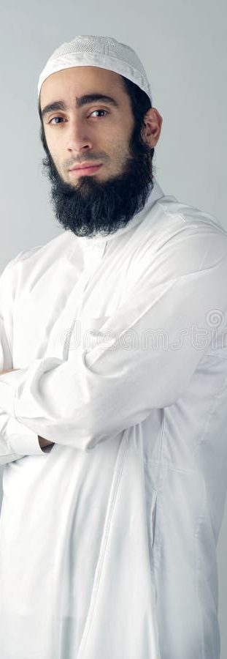
PERSONALITY
BIO
Hardworking,
Community Oriented
Optimistic
Omar was granted refugee status after fleeing war in his home country. He is eager to build a stable life for his family and contribute to society. He has prior experience as a small business owner and hopes to start a new business.
Motivations
LEGAL STATUS & WORK RIGHTS
FAMILY WELLBEING
EDUCATION & CAREER
COMMUNITY INTEGRATION
Goals
Challenges
Access startup resources and loan applications.
Connect with mentors and business networks.
Find local events and integration programs.
Navigating business registration and legal compliance.
Securing funding without credit history.
Building business contacts and customer base.
Needs / Wants
Pain Points
Omar Dabo
Information and guidance in starting a business
Childcare support.
Attendance of local events
Difficulty accessing financial support due to complex regulations.
Difficulty with paperwork and bureaucracy when registering for a business.
Difficulty balancing career goals with family/community time.
40, Male
Refugee
How the Web Application Addresses Needs:
^{STATUS:}
^{Divorced}
^{Dependents:}
^{3 children}
Provides access to startup guides, legal templates, financial aid resources.
Provides access to support groups within online forums for childcare support
Provides an interactive local events calendar for networking and cultural integration.

Slide 4
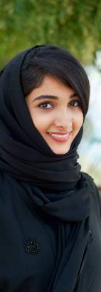
PERSONALITY
BIO
Ambitious
Resourceful
Hopeful
Amina arrived as a refugee after escaping conflict in her country. She is determined to rebuild her life, pursue higher education, and contribute to society. She currently studies part-time while working in a café.
Motivations
LEGAL STATUS & WORK RIGHTS
FAMILY WELLBEING
EDUCATION & CAREER
COMMUNITY INTEGRATION
Goals
Challenges
Find scholarships, financial aid, and work-study options.
Connect with career mentors and networking groups.
Access internship listings and job application resources.
Navigating financial aid and scholarship applications.
Finding career guidance suited to her refugee status.
Overcoming workplace discrimination and gaining experience.
Needs / Wants
Pain Points
Amina Yusuf
Scholarship awards for financial assistance in pursuing education
Career mentorship with guidance and networking.
Help with developing a resume and obtaining internships
Difficulty balancing work, study, and finances.
Limited industry contacts and knowledge of job opportunities.
Doesn’t know how to break through career barriers.
22, Female
Refugee
How the Web Application Addresses Needs:
^{STATUS:}
^{Single}
^{Dependents:}
^{N/A}
Provides access to scholarship information with refugee-specific grants.
Provides a platform for mentorship & careers guidance which connects mentors with mentees
Provides a job search tool with targeted filters to cater for a refugee’s situation / environment

